Slide 1


ANOMALY DETECTION WITH GENAI

Slide 2

Module Agenda
Introduction to Anomaly detection
Anomaly detection applications
Techniques for Anomaly detection
Anomaly detection using Z-score Method
Anomaly Detection using Isolation Forest
Live Demo 1: GenAI for sales anomaly detection using the Z-Score method
Live Demo 2: Walmart store anomaly detection using GenAI
Practice Opportunity
© All rights reserved for Dr. Ryan Ahmed @Stemplicity Inc.

Slide 3
INTRODUCTION TO ANOMALY DETECTION

Slide 4
Financial Planning and Analysis
Data Wrangling & Analysis: Automate reconciliation and analysis of financial data.
Competitor Analysis: Analyze competitors' financials and strategic positioning.
Anomaly Detection: Identify errors in financial transactions with AI.
Time Series Forecasting: Predict financial performance using historical data and market trends.
Variance Analysis: Analyze actuals vs. budgets to pinpoint variances and corrective actions.
Scenario Planning: Model scenarios to evaluate business decisions' financial impacts.
Financial Narratives: Generate AI-driven insights for clear stakeholder communication.
Cost Optimization: Identify inefficiencies and recommend cost-saving measures.
Data Visualization: Visualize financial data for strategic decision making
Financial Prediction Using ML Regression: Predict financial metrics such as revenues& expenses.
Financial Planning and Analysis (FP&A) is a critical business function that focuses on providing financial insights to support decision-making and drive a company’s strategic objectives.
It involves analyzing financial data, forecasting future financial performance, budgeting, and offering recommendations to enhance financial health and operational efficiency.
© All rights reserved for Dr. Ryan Ahmed @Stemplicity Inc.

Slide 5

What is anomaly detection?
Anomaly detection is the process of identifying data points, events, or observations that significantly deviate from the norm or expected behavior within a dataset.
These "anomalies" can indicate unusual events, errors, or important insights that are different from most of the data.
© All rights reserved for Dr. Ryan Ahmed @Stemplicity Inc.

Slide 6
Applications of Anomaly Detection
Cybersecurity: Detecting intrusions, malware, and fraudulent activities.
Finance: Identifying credit card fraud and stock market anomalies.
Healthcare: Spotting abnormalities in diagnostics and patient monitoring.
Manufacturing: Detecting faults and enabling predictive maintenance.
Retail: Analyzing customer behavior and identifying inventory irregularities.
© All rights reserved for Dr. Ryan Ahmed @Stemplicity Inc.

Slide 7
Techniques for Anomaly Detection
Statistical Methods:
Example: A value with a z-score greater than 2 or 3 might be considered an outlier.
Machine Learning Methods:
Supervised learning: Models trained on labeled data (anomalous vs. normal) to classify future data points.
Unsupervised learning: Models detect data patterns and identify outliers without prior labels.
Time-Series Analysis:
Example: Identifying an unusual drop in website traffic in times when traffic is usually high.
Distance-Based Methods:
Use measures like mean, variance, and z-scores to identify anomalies.
In sequential data, algorithms detect anomalies based on trends, seasonality, and patterns.
Calculate distances between points and identify those far from most others as anomalies (e.g., using k-nearest neighbors).
© All rights reserved for Dr. Ryan Ahmed @Stemplicity Inc.

Slide 8
Z-Score Anomaly Detection

Slide 9
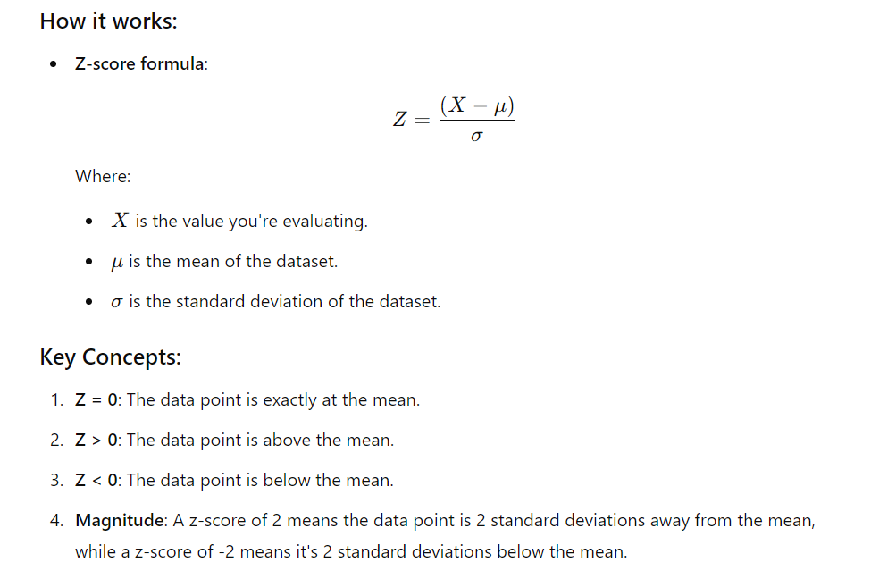
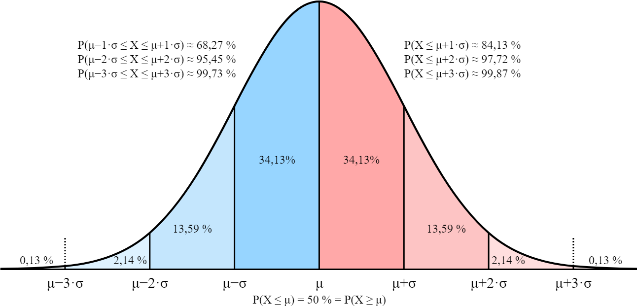
Z-Score
A z-score is a statistical measurement that tells you how far a data point is from the mean of a data set, in terms of standard deviations.
It helps determine if a value is typical within a distribution or an outlier.
© All rights reserved for Dr. Ryan Ahmed @Stemplicity Inc.
https://commons.wikimedia.org/wiki/File:Normal_Distribution_Sigma.svg

Slide 10
Z-Score
If the average unit sales for a store is 1000, with a standard deviation of 100.
A z-score of 2 means the sales were 1200 (2 standard deviations above the mean).
A z-score of -1 means the sales were 900 (1 standard deviation below the mean).
Why it's useful:
Identifying anomalies: High absolute z-scores (like |z| > 2 or 3) suggest that the value is far from the average and could be an outlier or anomaly.
Comparing different distributions: Z-scores standardize data, making it easier to compare values from different distributions.
In summary, the z-score helps you understand how unusual or typical a particular data point is relative to the entire dataset.
© All rights reserved for Dr. Ryan Ahmed @Stemplicity Inc.

Slide 11
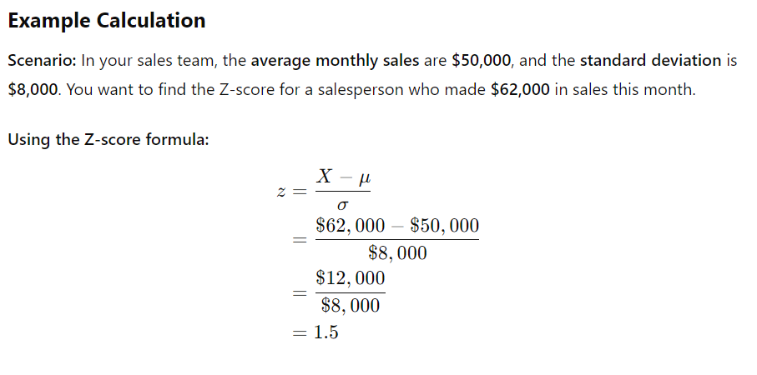
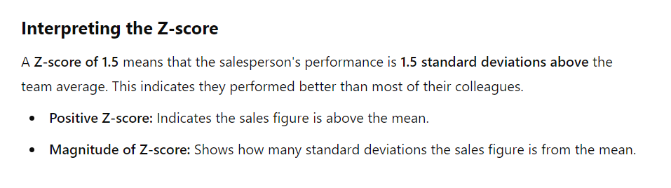
Z-Score example 1
Imagine you're a sales director analyzing your team’s monthly sales figures. If the average salesperson typically makes $50,000 in sales per month, and one salesperson achieves $62,000, their Z-score would be high because they performed better than most.
Conversely, if another salesperson only makes $35,000, their Z-score would be low, indicating they underperformed compared to their peers.
The Z-score helps us understand how different or similar a salesperson's performance is compared to the typical performance within the team.
© All rights reserved for Dr. Ryan Ahmed @Stemplicity Inc.

Slide 12
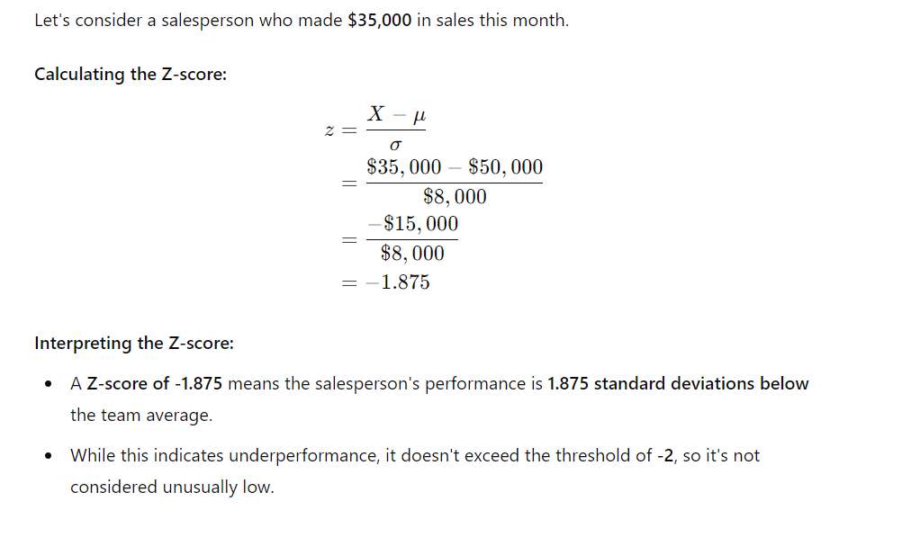
Z-Score example 2
© All rights reserved for Dr. Ryan Ahmed @Stemplicity Inc.

Slide 13
LIVE DEMO 1: Z-SCORE FOR SALES ANOMALY DETECTION

Slide 14
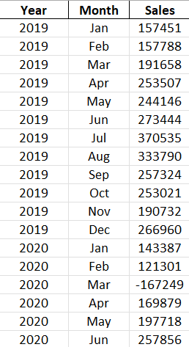
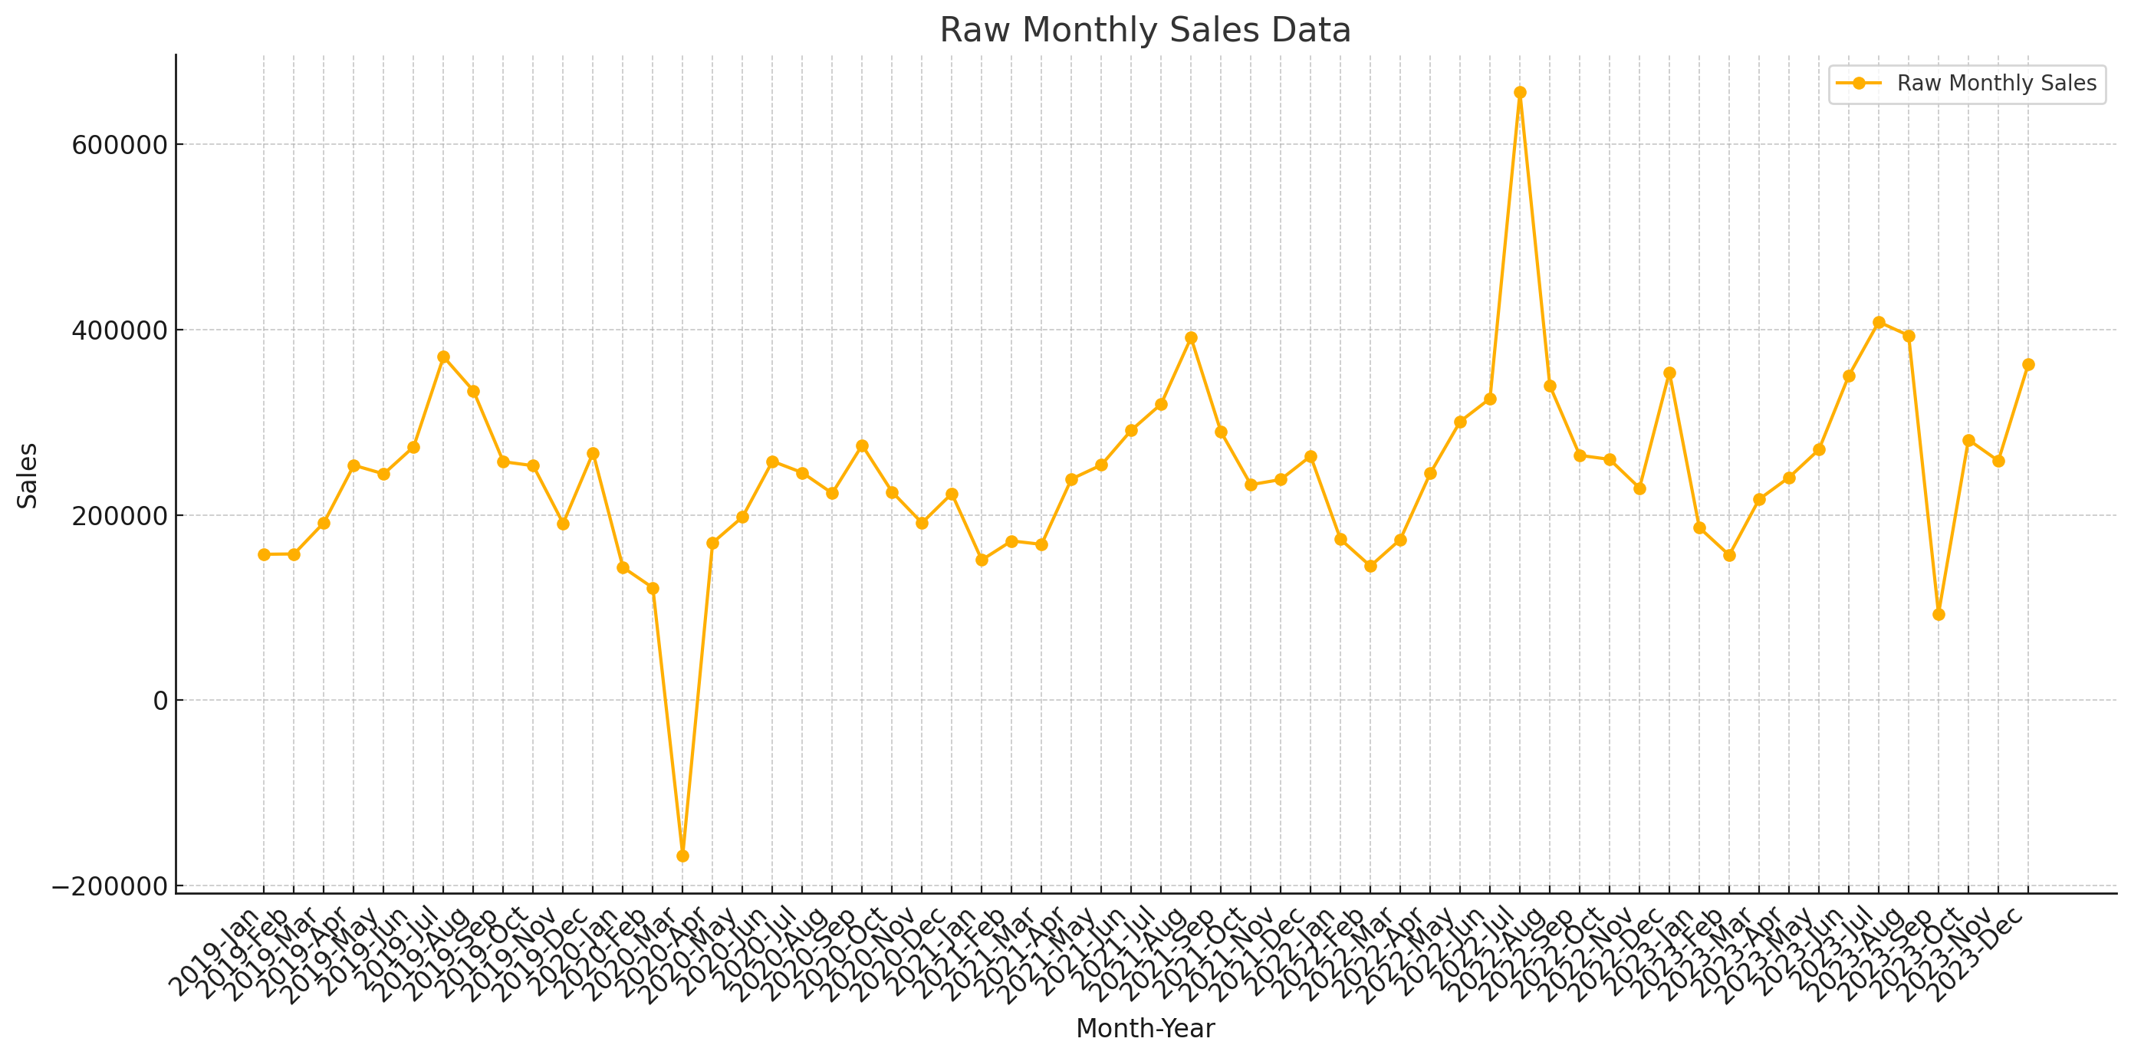
Live Demo: Z-Score for Anomaly Detection Example
The objective is to use Generative AI (Custom GPTs) to identify anomalies in a company's monthly sales data using Z-score analysis. Anomalies are defined as months with Z-scores greater than 2 or less than -2, which indicate significant deviations from the average sales trend.
The goal is to compute Z-scores for the data, detect anomalous months, visualize these findings, and interpret their business implications.
© All rights reserved for Dr. Ryan Ahmed @Stemplicity Inc.

Slide 15
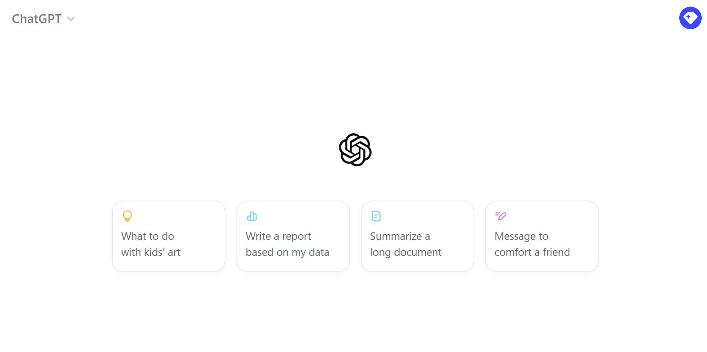
Live Demo: Z-Score for Anomaly Detection Example
🔗 Click here to explore ChatGPT ChatGPT Signup
💡 Click here for AI Prompts Explore Prompts
© All rights reserved for Dr. Ryan Ahmed @Stemplicity Inc.

Slide 16
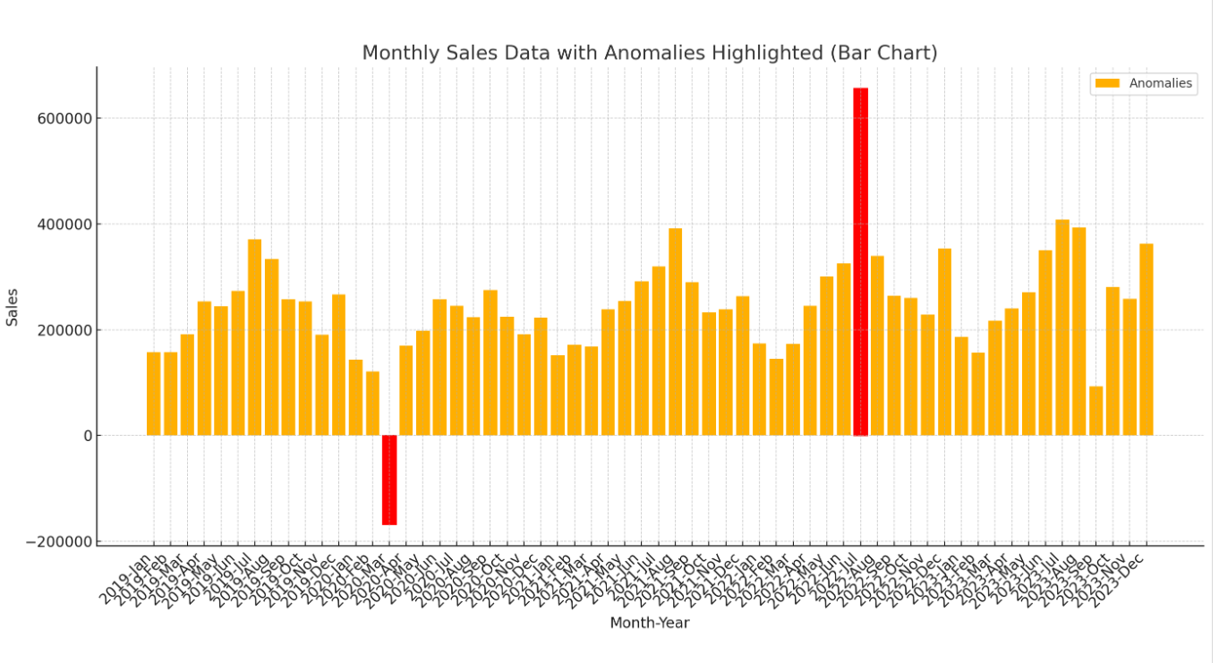
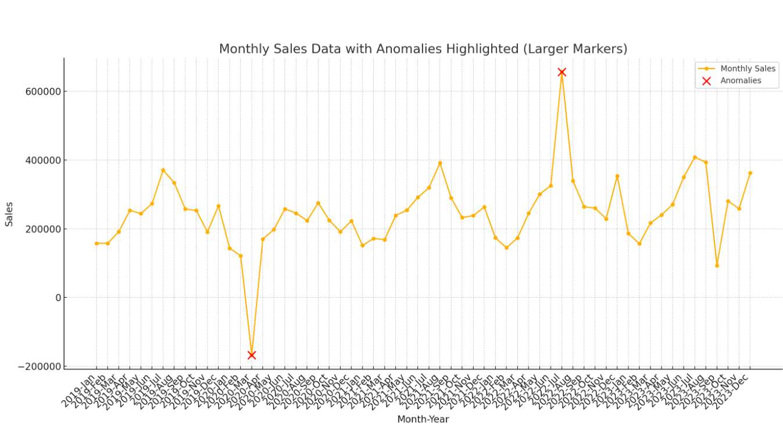
Live Demo: Z-Score for Anomaly Detection Example
© All rights reserved for Dr. Ryan Ahmed @Stemplicity Inc.

Slide 17
ISOLATION FOREST FOR ANOMALY DETECTION

Slide 18
Isolation Forest
The Isolation Forest algorithm is an unsupervised learning algorithm used for anomaly detection. It works by isolating points in the dataset, with anomalies (outliers) being easier to isolate than normal points.
Outlier:
Easy to isolate
Outlier:
Easy to isolate
© All rights reserved for Dr. Ryan Ahmed @Stemplicity Inc.
Regular data point: difficult to isolate

Slide 19
Recall Decision Trees
A decision tree is a widely used machine learning algorithm used to solve classification and regression problems.
It is a tree-structured algorithm that includes a sequence of decisions and their possible outcomes. In decision trees, data is split according to a certain condition.
Let’s assume that we want to classify whether a bank customer is eligible to retire based on features such as savings and age.
© All rights reserved for Dr. Ryan Ahmed @Stemplicity Inc.
Savings>$1M
Age
Yes
No
55 years
Age > 55?
Class 0
Yes
No
Class 1
Class 0
$1 Million
Savings

Slide 20
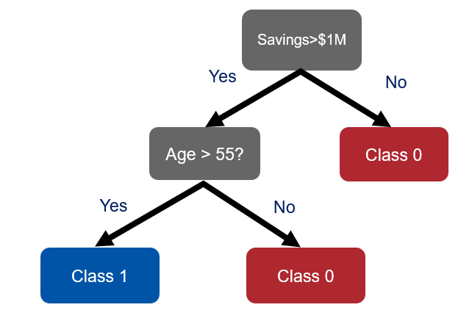
Recall Random Forest
Instead of basing predictions on the results of a single decision tree, why not use the predictions of an ensemble of models?
Random Forest is a type of ensemble algorithms that combines predictions from a collection of models. Ensemble algorithms typically generates more accurate and stable predictions compared to a single model.
Random Forest works by creating a set of decision trees from randomly selected subset of data. It then combines votes or average values from different decision trees to generate a final prediction which represents the “wisdom of the crowds”.
© All rights reserved for Dr. Ryan Ahmed @Stemplicity Inc.
Decision Tree 1
Decision Tree 2
Decision Tree N
Random Forest
MAJORITY VOTE = CLASS #1

Slide 21
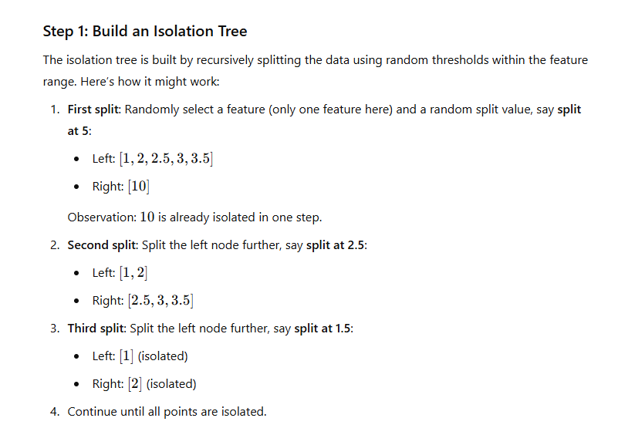
Isolation Forest Practical Example
Assume that we have the following data points, and we would like to build an isolation tree.
[1, 2, 2.5, 3, 3.5, 10]
[1, 2, 2.5, 3, 3.5, 10]
Split at 5
Anomalous point
Split at 2.5
End
[1, 2, 2.5, 3, 3.5]
[10]
[1, 2]
Split at 1.5
End
© All rights reserved for Dr. Ryan Ahmed @Stemplicity Inc.
[2.5, 3, 3.5]
[1]
End
End
[2]

Slide 22
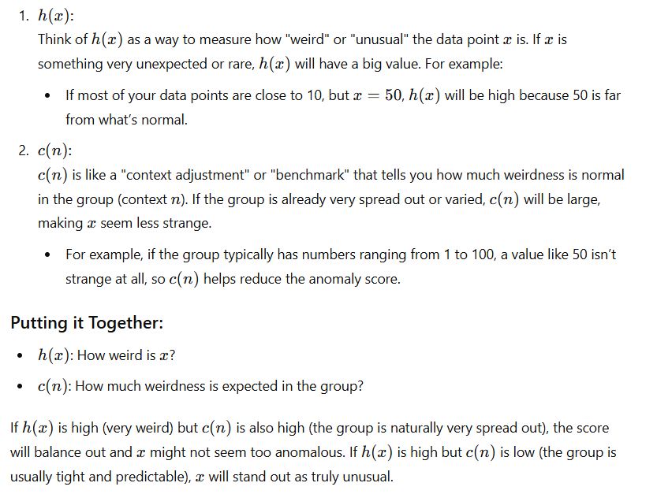
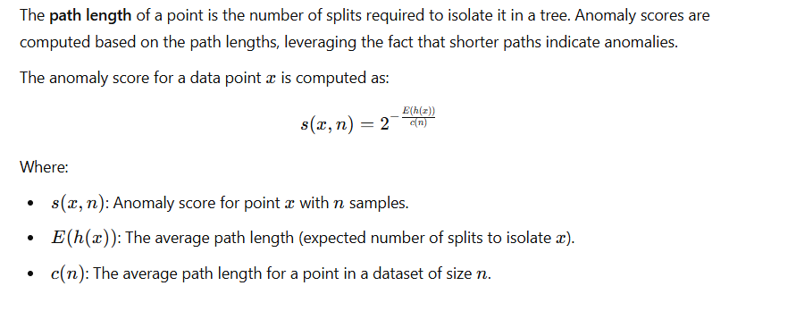
Isolation Forest Math
Every data point is given an anomaly score using the following formula:
© All rights reserved for Dr. Ryan Ahmed @Stemplicity Inc.

Slide 23
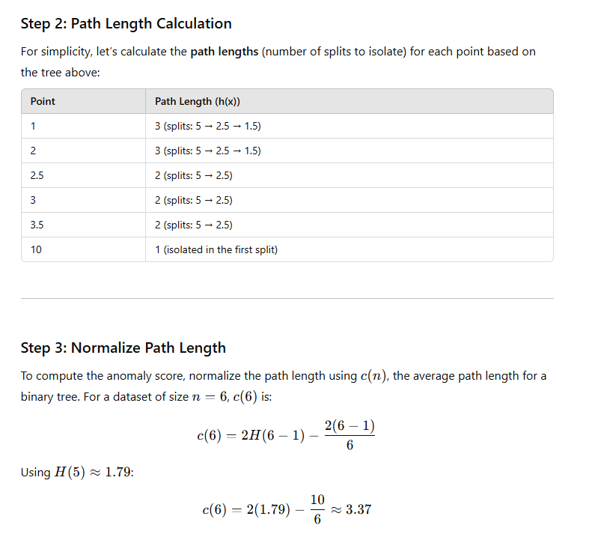
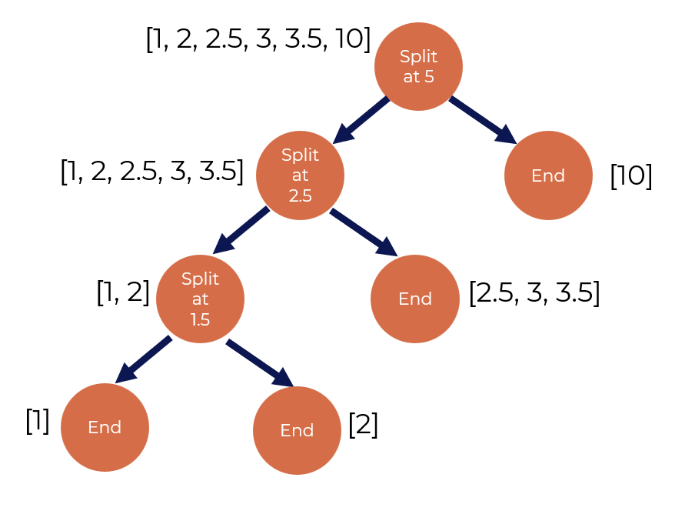
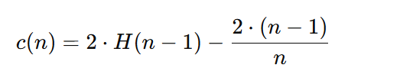
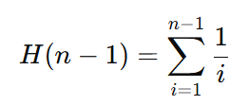
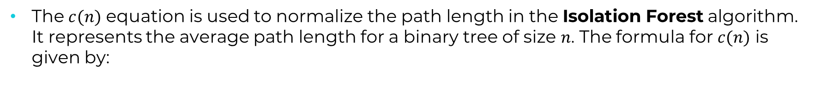
Isolation Forest Practical Example
© All rights reserved for Dr. Ryan Ahmed @Stemplicity Inc.
The $c(n)$ equation is used to normalize the path length in the Isolation Forest algorithm. It represents the average path length for a binary tree of size $n$. The formula for $c(n)$ is given by:
$H(n−1)$is the harmonic number, calculated as:

Slide 24
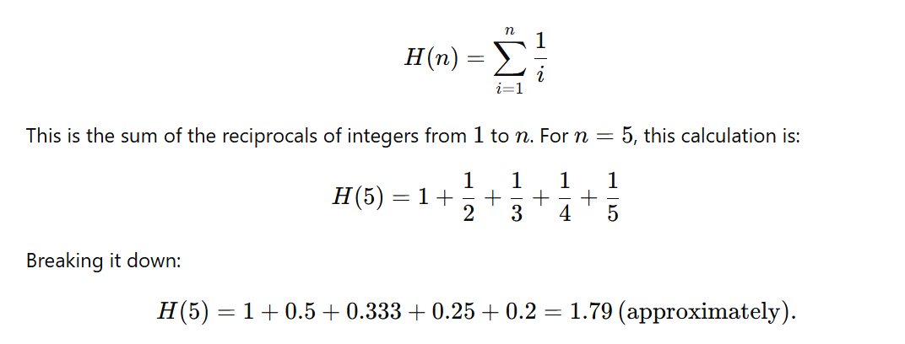
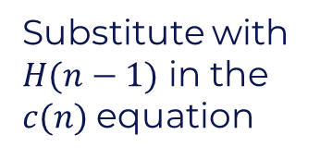
Isolation Forest Practical Example
Substitute with $H(n−1)$ in the $c(n)$equation
© All rights reserved for Dr. Ryan Ahmed @Stemplicity Inc.

Slide 25
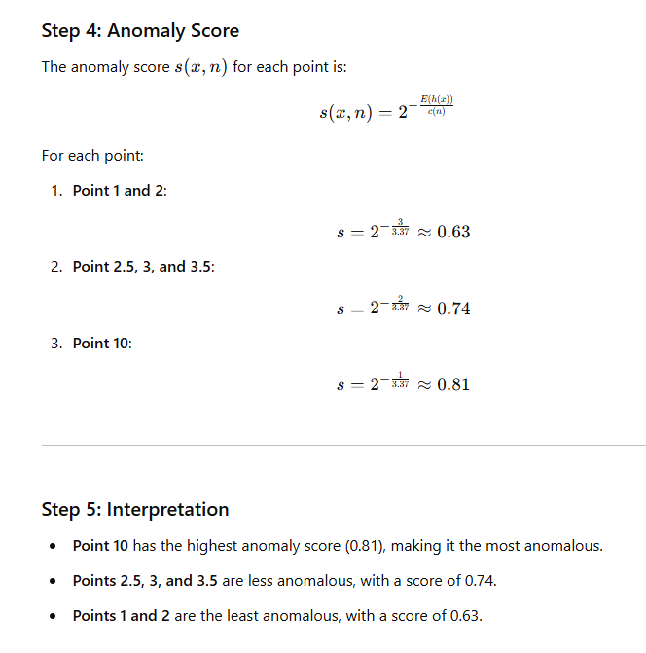
Isolation Forest Practical Example
Anomalous point
© All rights reserved for Dr. Ryan Ahmed @Stemplicity Inc.

Slide 26
PRACTICE OPPORTUNITY

Slide 27

Practice Opportunity
Identify Anomalies with Isolation Forest:
Leverage the Isolation Forest algorithm to detect anomalies in a company's monthly sales data.
Visualize the detected anomalies using intuitive plots to highlight deviations from normal patterns.
Analyze the business implications of these anomalies, such as identifying potential issues or opportunities in sales trends.
Compare Results with Z-Score Analysis:
Compare and contrast the results from the Isolation Forest to the Z-score, discussing their similarities, differences, and relative effectiveness.
Experiment with Additional Methods:
Explore and implement at least one other anomaly detection technique not covered in class.
Evaluate the performance and insights provided by these alternative methods in the context of the dataset.
© All rights reserved for Dr. Ryan Ahmed @Stemplicity Inc.

Slide 28
Practice Opportunity Solutions
🔗 Click here to explore ChatGPT ChatGPT Signup
💡 Click here for AI Prompts Explore Prompts
💡 Click here for Practice Opportunities Solution Explore Prompts
© All rights reserved for Dr. Ryan Ahmed @Stemplicity Inc.

Slide 29
LIVE DEMO 2: GENAI FOR WALMART’S ANOMALY DETECTION

Slide 30
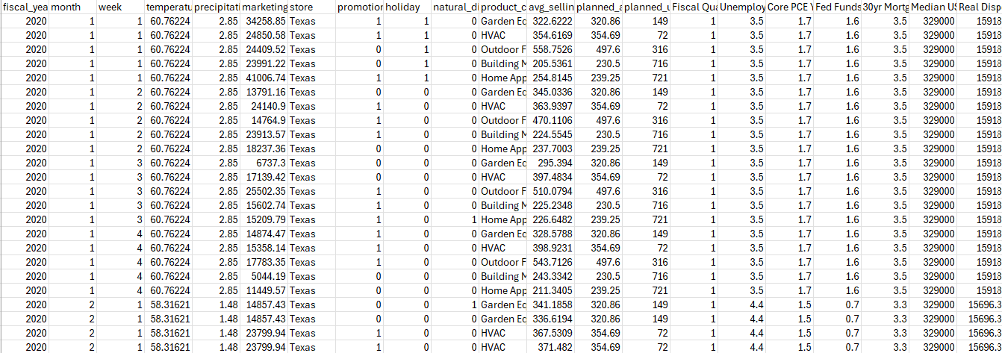
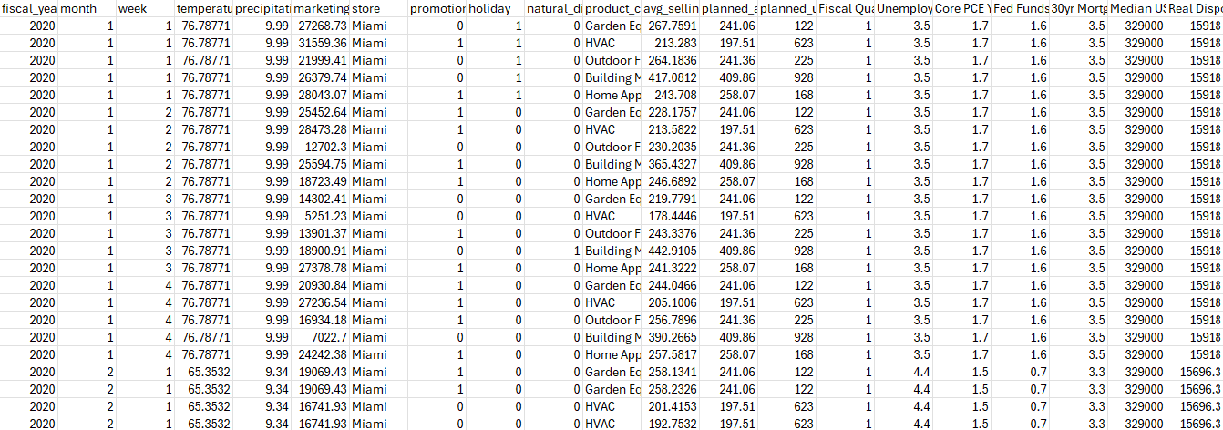
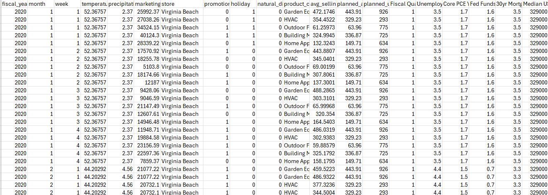
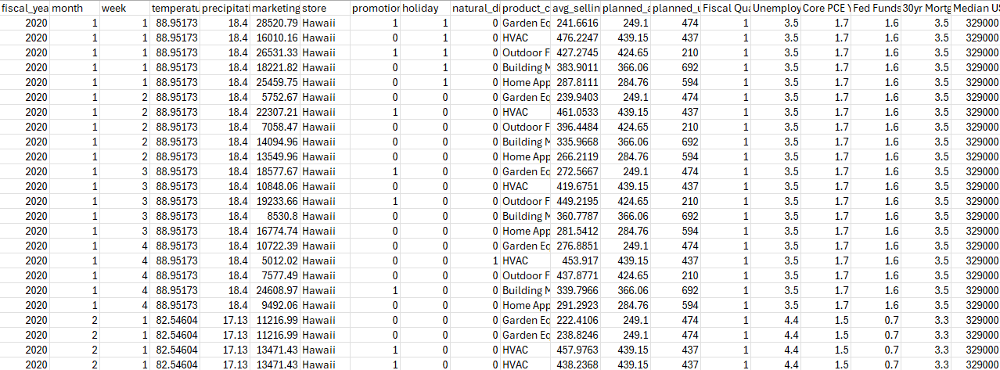
Problem Statement
The objective is to use Generative AI (Custom GPTs) to identify Walmart’s sales data anomalies.
Data across 4 different stores (Miami, Texas, Hawaii, and Virginia) are as shown below:
© All rights reserved for Dr. Ryan Ahmed @Stemplicity Inc.

Slide 31
Live Demo 2: Anomaly Detection for Walmart Store
🔗 Click here to explore ChatGPT ChatGPT Signup
💡 Click here for AI Prompts Explore Prompts
© All rights reserved for Dr. Ryan Ahmed @Stemplicity Inc.

Slide 32
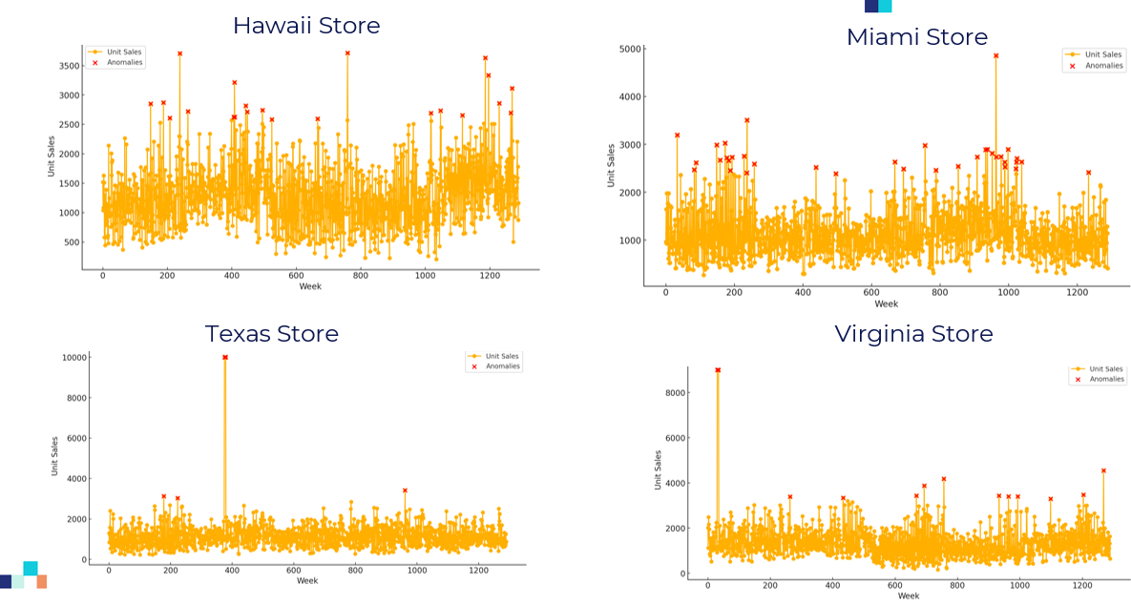
Anomaly detection for individual stores – Run 1
© All rights reserved for Dr. Ryan Ahmed @Stemplicity Inc.

Slide 33
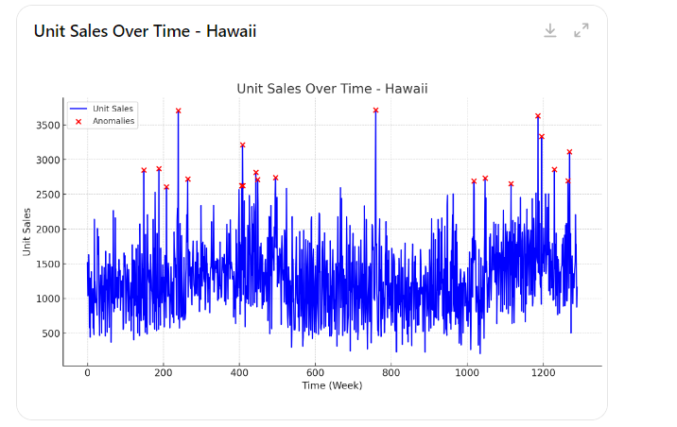
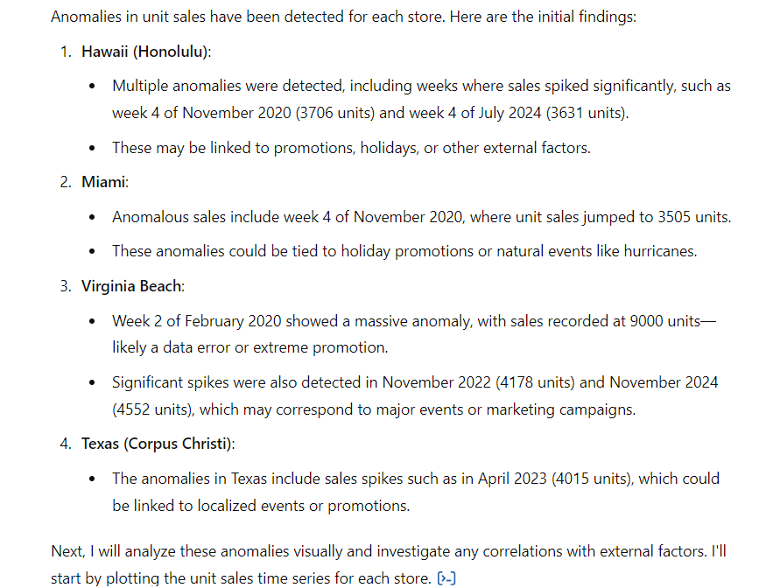
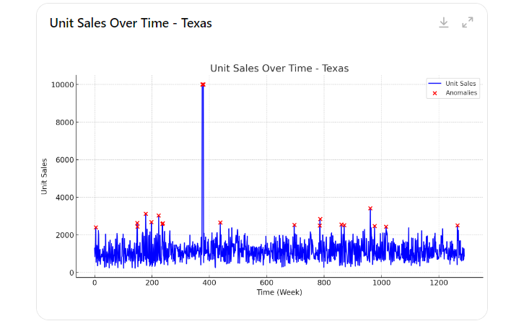
Anomaly detection for individual stores – Run 2
© All rights reserved for Dr. Ryan Ahmed @Stemplicity Inc.

Slide 34
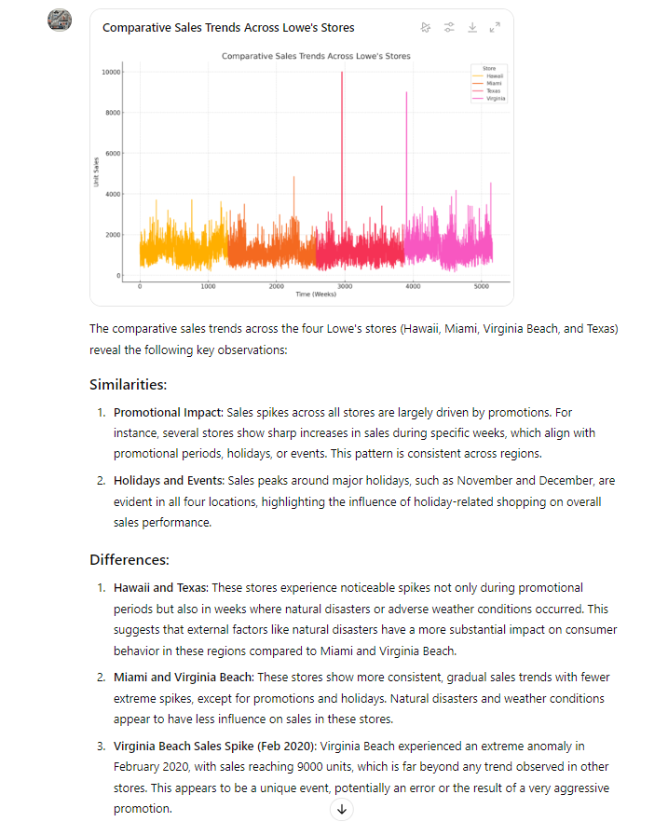
Anomaly detection for all stores
© All rights reserved for Dr. Ryan Ahmed @Stemplicity Inc.

Slide 35
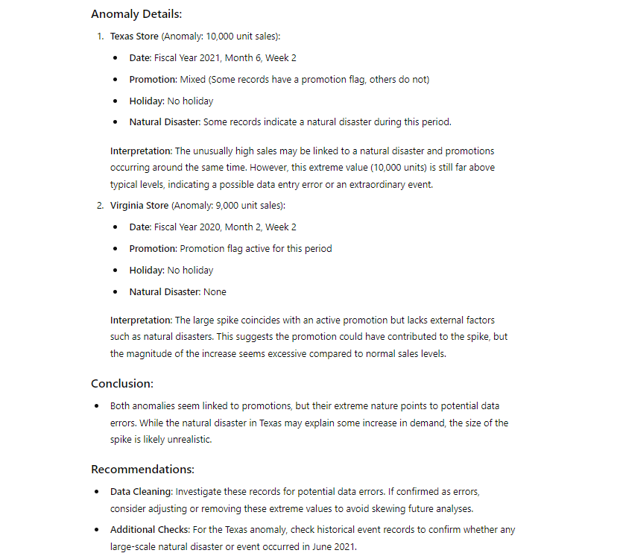
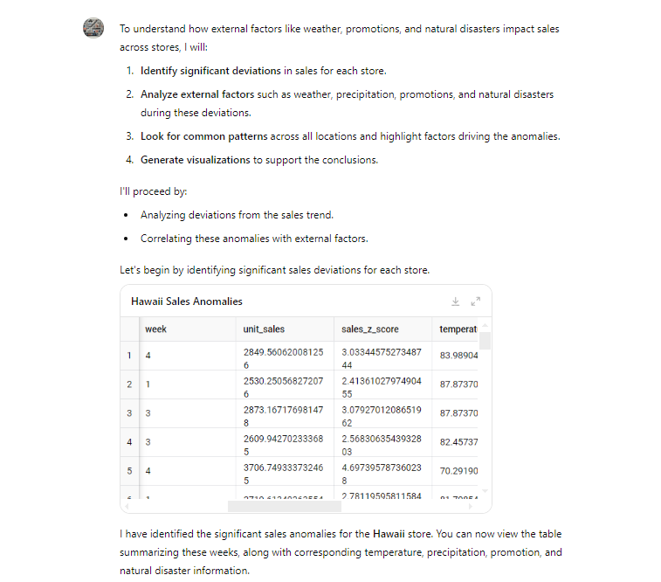
Anomaly detection continued
© All rights reserved for Dr. Ryan Ahmed @Stemplicity Inc.

Slide 36
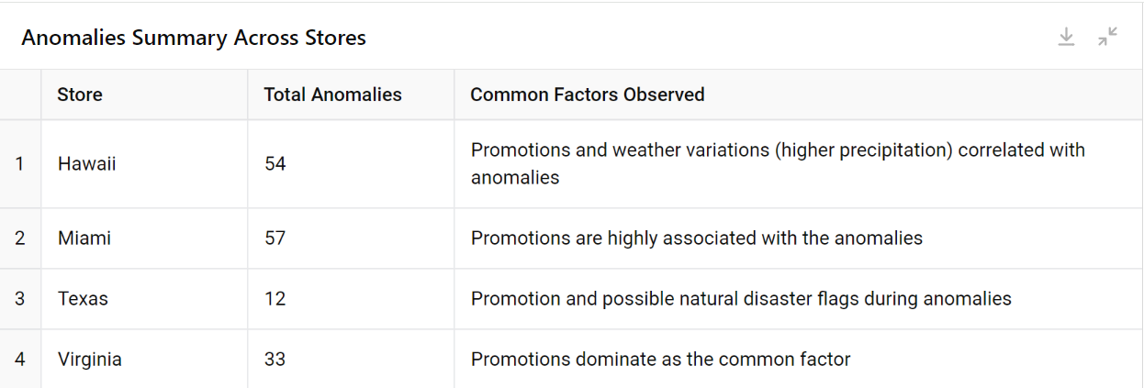
Anomaly detection continued
© All rights reserved for Dr. Ryan Ahmed @Stemplicity Inc.

Slide 37
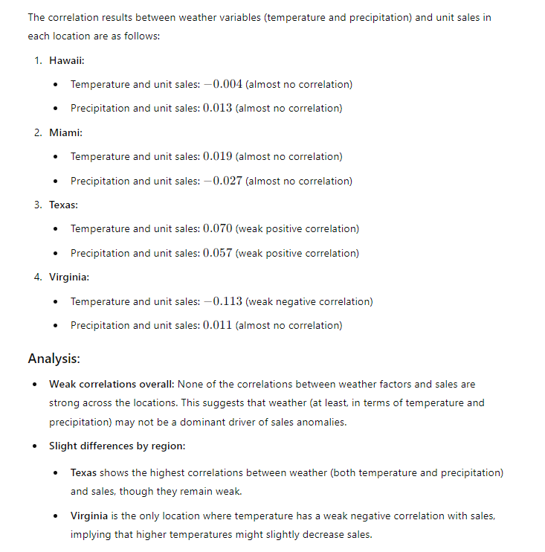
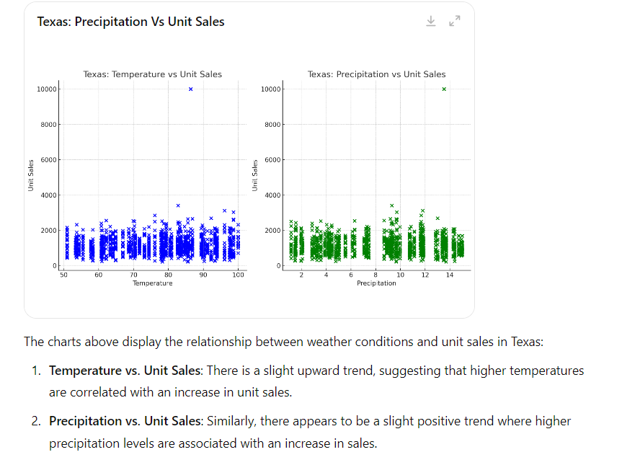
Anomaly detection continued
© All rights reserved for Dr. Ryan Ahmed @Stemplicity Inc.

Slide 38
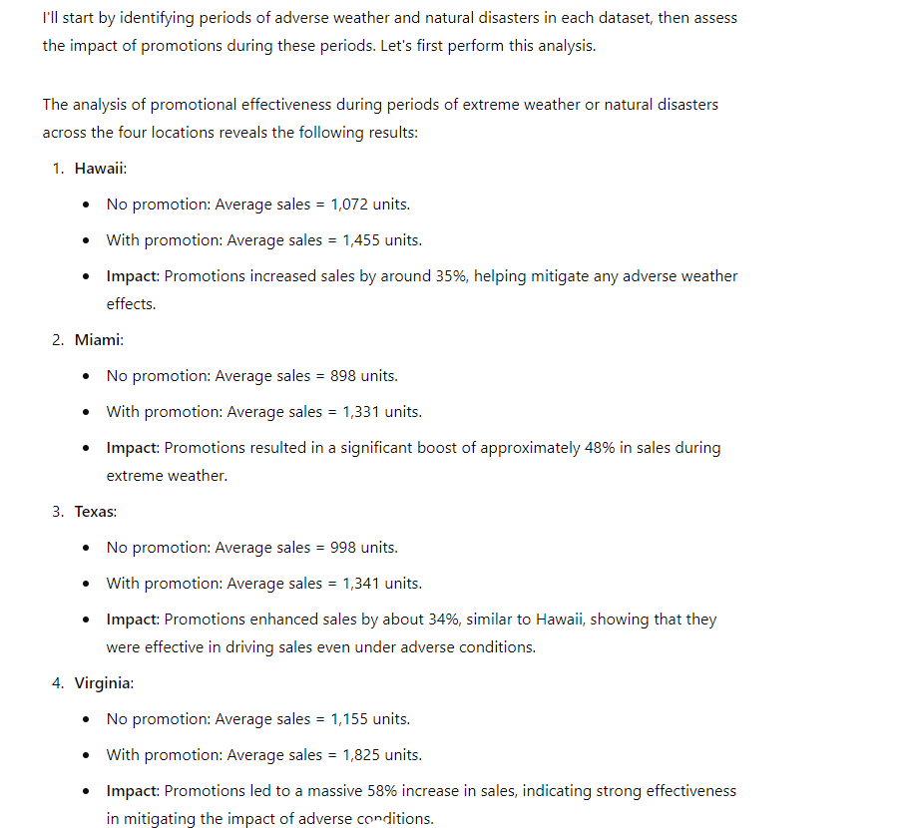
Anomaly detection continued
© All rights reserved for Dr. Ryan Ahmed @Stemplicity Inc.

Slide 39
Thank you!

